Slide 1
Classrooms of the Future
Design with Students in Mind
Dr. Lesley Clifton, CCIS Executive Director
Jonelle Godfrey, Principal, Diego Valley Charter School

Slide 2
Paradigm Shifts
Notes:
Discussion in Groups:
What are the top three paradigm shifts in education?
We selected Personalization, Information Availability, and Student vs. Teacher-Centered Learning (not necessarily in this order)

Slide 3
Personalization
Notes:
Discussion:
What are some other areas that we personalize?

Slide 4
Information Availability

Slide 5
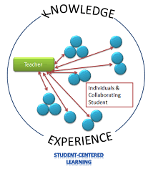
Teacher vs. Student-Centered Learning
Notes:
Discuss paradigm shift from teacher centered to student centered learning
No more sage on the stage, but guide on the side
Rows of desks and chairs facing the whiteboard are no longer appropriate
Discussion in groups:
What does student-centered learning mean?
What does/should that look like?

Slide 6
What does this mean for schools?
Notes:
Just a thought

Slide 7
What do you need in a classroom?
Notes:
Have individuals/teams create a list of what they believe needs to be in a classroom.

Slide 8
Do you really need that in a classroom?

Slide 9
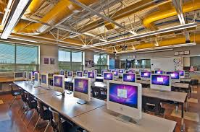
Current “new” design
Notes:
Talk about new schools:
Desktops not laptops or tablets
Maybe be movable, but still centered on the whiteboard
Windows, bright, still centered on whiteboard and teacher

Slide 10
Current “new” design
Notes:
Talk about new schools:
Desktops not laptops or tablets
Maybe be movable, but still centered on the whiteboard
Windows, bright, still centered on whiteboard and teacher

Slide 11
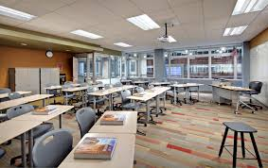
Current “new” design
Notes:
Talk about new schools:
Desktops not laptops or tablets
Maybe be movable, but still centered on the whiteboard
Windows, bright, still centered on whiteboard and teacher

Slide 12
Ideas

Slide 13
Learn4Life
Notes:
Career preparatory CTE Career Pathways
Trauma-sensitive
Mastery-based
Self-directed

Slide 14
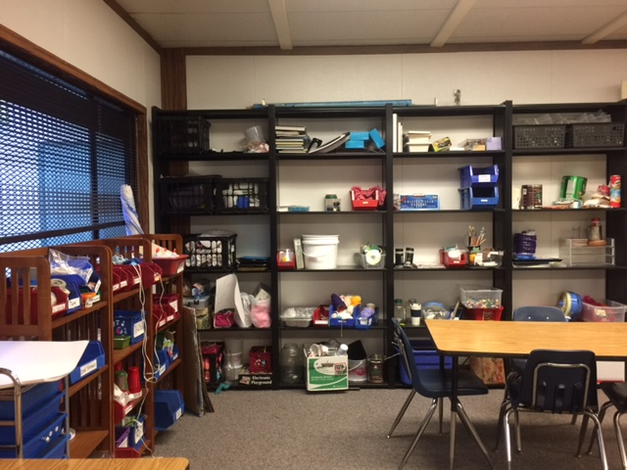
Vista Visions
Notes:
Great Student Café
And a Maker Space!

Slide 15
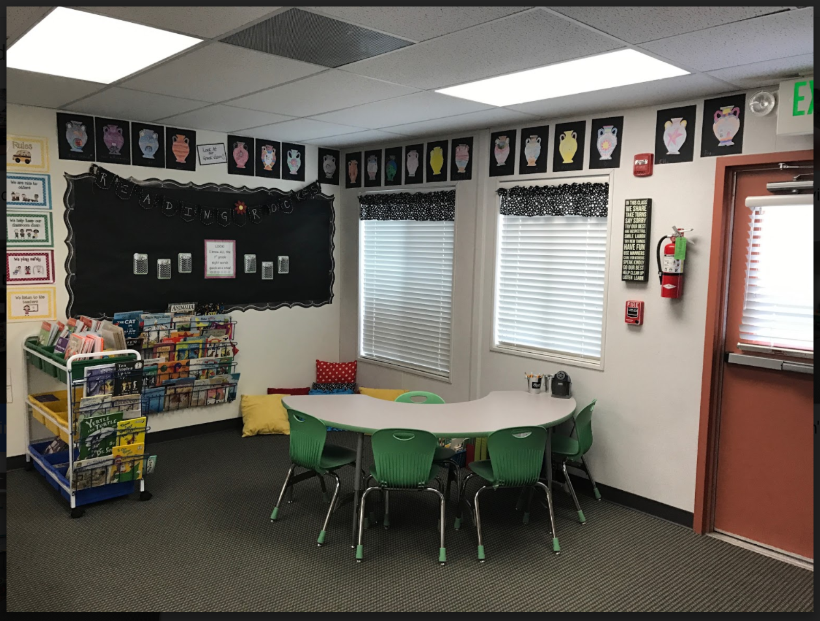
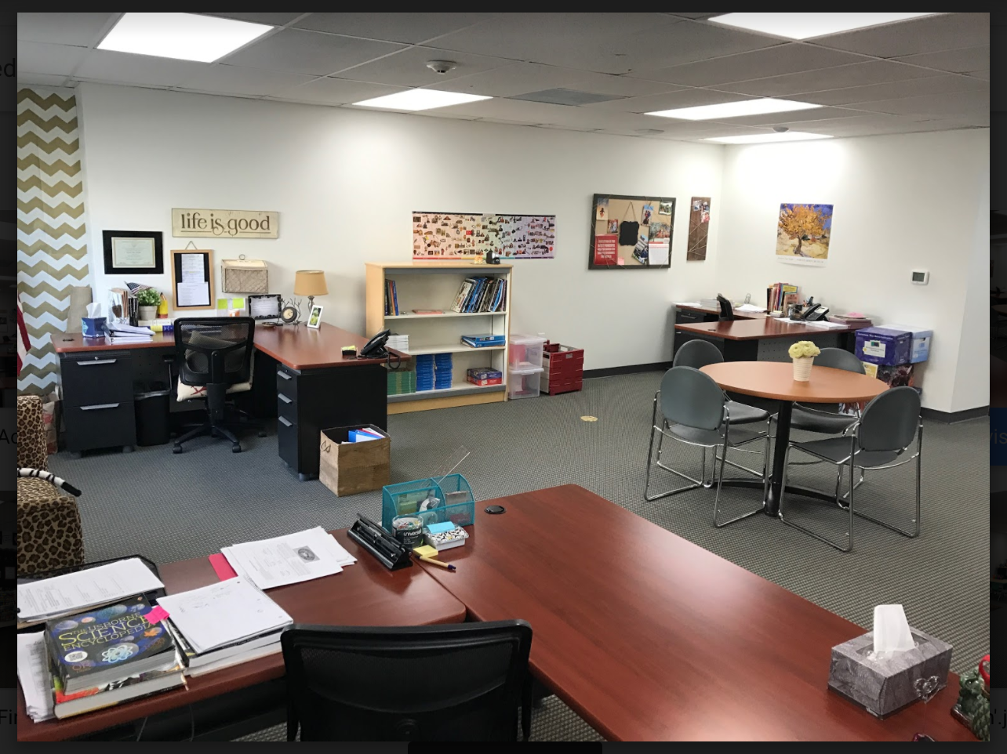
Heritage Flex Academy
Notes:
Teacher spaces don’t have to be boring!
Reading corner, movable, lightweight furniture, colorful, friendly spaces

Slide 16
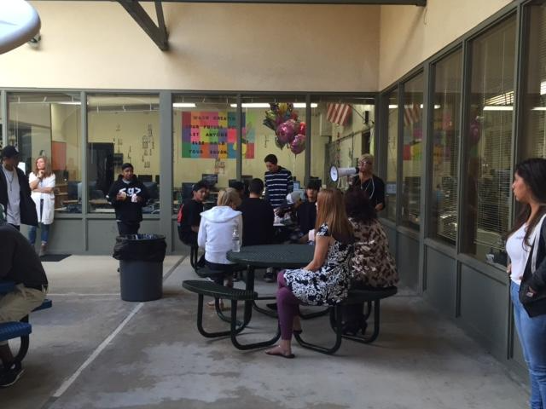
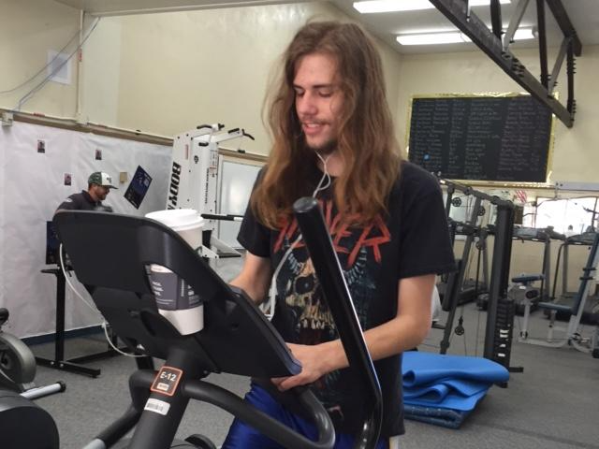
Claire Burgener, OUSD
Notes:
Indoor/outdoor spaces
A gym on campus where students walk and read
Student lounge with comfy furniture and bright colors

Slide 17
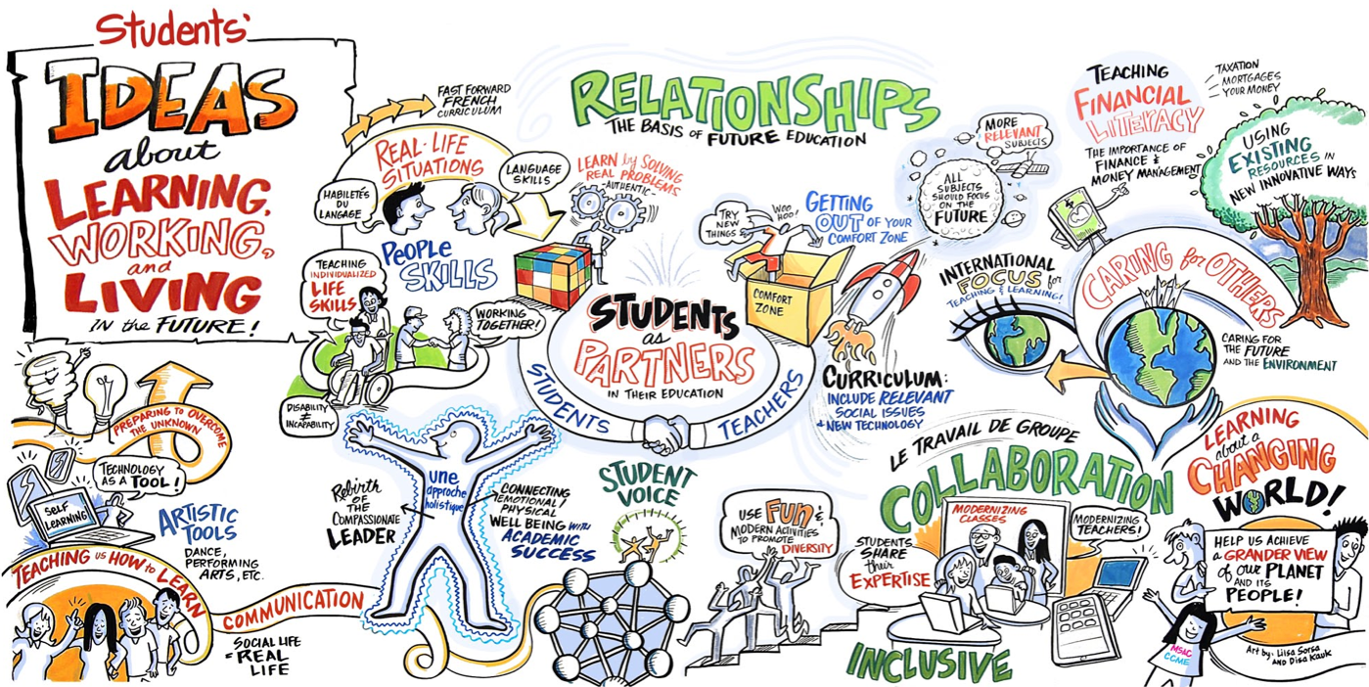
Notes:
Keep in mind…
Students see relationships, collaboration, partnerships, communication, financial literacy, real-life situations, people skills, caring for others, and conservation as importnat for their future. Are we designing with their needs in mind?

Slide 18
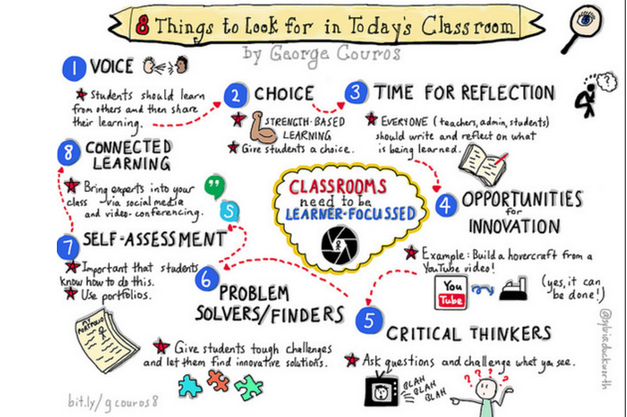
Notes:
Is your classroom designed with these ideas in mind?

Slide 19
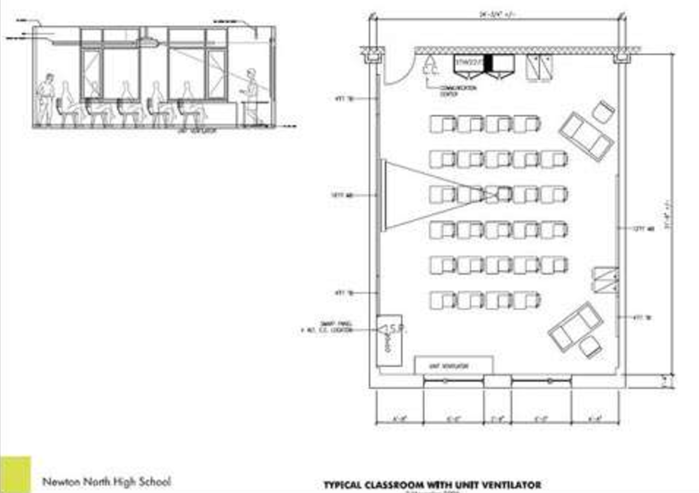
Back to Reality, but not really
Notes:
We know there are some limitations (30x30, etc) and we work with finite spaces, but…

Slide 20
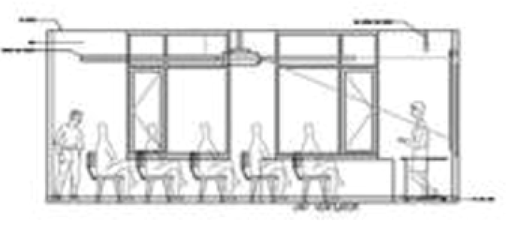

Slide 21
Do you really need that in a classroom?
Notes:
Edit your Mindmap. What do you need? What do you not need? What do you want?

Slide 22
Padlet
Notes:
Time to get messy!

Slide 23
Share, share, share
Notes:
Give Lesley images and she will add to padlet.

Slide 24
Please complete the feedback survey on SCHED

