Slide 1
Keynote 2017 CCIS Spring Conference

Slide 2
Political Backdrop
Consequential election year for K-12 education
Proposition 55 extends high-income earner tax
Proposition 51 and local school bonds combined allow for nearly $27 billion investment in school building and modernization
Democrats capture two-thirds majority in both houses
Rise of the “Mods” blunts impact of control
Eye toward maintaining super-majorities may prevent the full exercise of new power
Federal policies unpredictable
K-12 Funding?
Vouchers or Charters?
Will Friedrich’s Case Re-emerge?

Slide 3
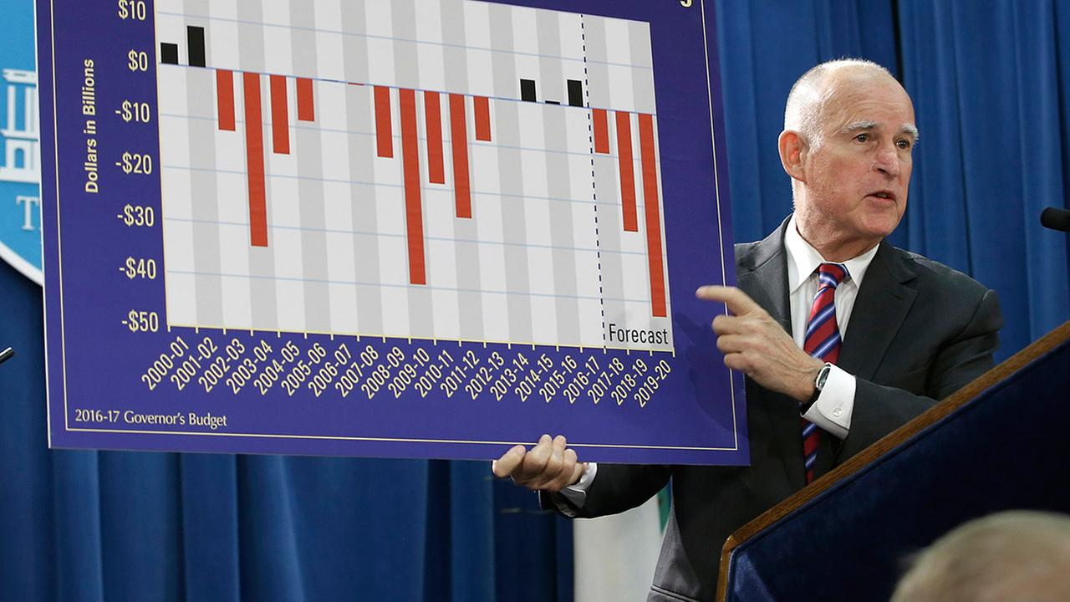
“This year’s budget will be the most difficult that we have faced since 2012. The surging tide of revenues that we enjoyed the past few years appears to have turned.”
- Governor Edmund G. Brown, Jr., January 10, 2017

Slide 4
Initial Thoughts
No surprises from Governor Brown
Conservative revenue estimates
Cautious spending plan with no new programs
Backdrop of general economic uncertainty
K-12 budget is straightforward, but pension costs raising serious concerns
Legislature may have other priorities, but all sides will have to wait for May revenue numbers
LAO believes Governor’s 2017-18 revenue estimates are low and inconsistent with his economic outlook

Slide 5
Sco monthly tax receipts
 | Actual Over or (Under) Estimates
FY 2016 | Amount* | Percentage
Total through July 31 | ($591) | (9.8%)
Total through August 31 | ($166) | (1.2%)
Total through September 30 | ($14) | (0.1%)
Total through October 31 | ($345) | (1.1%)
Total through November 30 | $212 | 0.5%
Total through December 31 | ($1,666) | (3.1%)
Total through June 30 | ?? | ??
*Cumulative Dollars in Millions

Slide 6
State general fund revenues projected

Slide 7
General fund spending and reserves
$122.5 billion GF spending (including transfers)
$2.3 billion Prop 2 “Rainy Day” transfer, half to Budget Stabilization Account (BSA) and half to pay down state debts and liabilities
BSA projected to reach $7.9 billion by end of 2017-18
Total general fund reserve is almost $9.5 billion, including the $1.6 billion discretionary general fund reserve

Slide 8
“Budget Solutions”
The Governor identifies a potential $1.6 billion budget deficit by end of 2017-18, but includes about $3.2 billion in actions to reduce spending growth
$1.7 billion from adjustments to Prop 98 guarantee
$400 million – eliminate affordable housing funding
$300 million – cancel transfer for state office buildings
$104 million – delay child care rate augmentations
$657 million in other actions

Slide 9
Governor’s Budget 2017-18 K-12 Education budget

Slide 10
K-12 proposal – Overview
$73.5 billion for Prop 98 ($64 billion for K-12)
$744 million increase for LCFF (funding 23.67% of remaining implementation gap)
$287 million one-time discretionary funding (mandate claims offset)
$423 million for Prop 39 energy efficiency grants
$200 million (one-time) for CTE incentive grants (per 2015 Budget Act)
$93 million for charter school ADA growth
$58 million to provide COLAs to categorical programs outside of the LCFF
$30 million for tobacco/nicotine prevention programs (Prop 56)
$10 million for reducing truancy and drop out rates and supporting victims of crime (Prop 47)
$2.4 million for county office COLA and ADA adjustments
-$4.9 million for Special Education ADA decrease

Slide 11
Prop 98 Changes Over Time (Billions of Dollars)

Slide 12
How does the governor reduce prop 98 expenditures to the lower guarantee in 2015-16 and 2016-17?
Step 1: Cut $379 million in funding from 2015-16 by “rescoring” funding to 2016-17, including $310 million in one-time discretionary funds and $14 million for the CCEE
Step 2: Cut $506+$379 million in funding from 2016-17, in large part by deferring $859 million in LCFF payments from June 2017 to July 2017
End result: $859 million of the 2017-18 guarantee is spent on the 2016-17 deferral rather than for increases to programs and services

Slide 13
lcff Entitlement target
Entitlement Target = Base Grant + Grade Span Adjustments (GSAs) + Supplemental Grant + Concentration Grant + Add-ons
Base Grant per ADA (with 1.48% COLA)
K-3 = $7,188 (up $105) 7-8 = $7,513 (up $110)
4-6 = $7,295 (up $106) 9-12 = $8,705 (up $127)
GSAs – 10.4% ($748; up $11) per K-3 ADA; 2.6% ($226; up $3) per 9-12 ADA

Slide 14
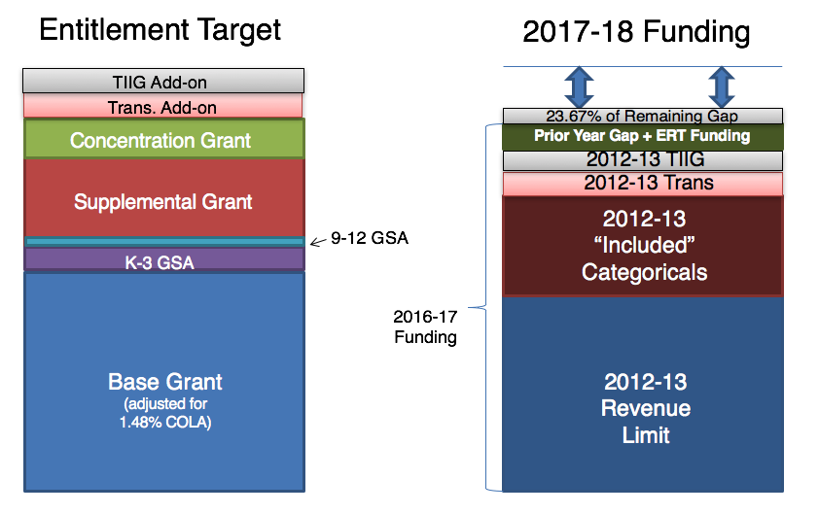
Lcff in one chart

Slide 15
Lcff gap closure estimates (Billions of dollars)
 | 2013-14 | 2014-15 | 2015-16 | 2016-17 | 2017-18 | 2018-19 | 2019-20 | 2020-21
Transition Funding | $2.087 | $4.722 | $5.994 | $2.942 | $.744 | $1.904 | $2.022 | $2.294
Gap Closure | 12.02% | 29.99% | 51.97% | 55.28% | 23.67% | 53.85% | 68.94% | 100%
COLA | 1.57% | 0.85% | 1.02% | 0.00% | 1.48% | 2.40% | 2.53% | 2.66%
Percent of Target Funded | 72% | 80% | 90% | 96% | 96% | 97%* | 98%* *estimated | 100%

Slide 16
Stand-alone categorical Programs
Proposed for Ongoing Funding (no COLA)
Adult Education ($500 million)
Adults in Correctional Facilities ($15.1 million)
After School Education and Safety Program ($547 million)
Agricultural Education Incentive Program ($4.1 million)
California Partnership Academies ($21.4 million)
California School Information Services ($5.8 million)
Child Nutrition – Breakfast Startup ($1 million)
College and Career Planning Website ($2.5 million)
County Office Fiscal Oversight ($5.3 million)
K-12 Internet Access ($8 million)
Specialized Secondary Programs ($4.89 million)
State Testing Program ($110.4 million)
Teacher Dismissal ($40,000)
Safe Neighborhoods and Schools Fund ($10.6)
Proposed for Ongoing Funding (1.48% COLA)
American Indian Early Childhood Education Program ($558,000)
American Indian Education Centers ($4.138 million)
Child Nutrition ($161 million)
Foster Youth Programs ($25.75 million)
Special Education ($3.149 billion)
One-Time Funding
CTE Incentive Grant ($200 million)

Slide 17
One-time discretionary funding
$287 million (total of more than $5 billion over 4 years) fully discretionary one-time funding to school districts, county offices, and charter schools
Considerably less than prior years – about $48 per ADA
Likely to change by final budget act based on negotiations and revised revenue estimates
Funds received will directly offset any unreimbursed state mandate claims, but all LEAs receive funds regardless of mandate claims

Slide 18
Governor’s Budget 2017-18 other KEY budget issues and programs

Slide 19
Rising pension costs: what has changed?
Market conditions
Last year, both CalSTRS and CalPERS experienced investment returns of nearly 0%
Analysts predicting greater economic uncertainty and lower yields
The investment risks required to meet 7.5% return are either impractical or impossible
Demographic changes
Longer life expectancy is increasing future benefit costs
Fund sustainability
Increased risk of negative cash flow and inability to meet long-term obligations

Slide 20
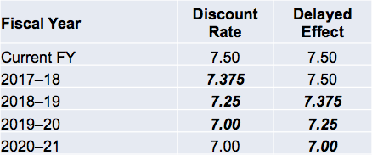
Rising pension costs: key Actions
In December 2016, the CalPERS board voted to decrease the assumed rate of return (“discount rate”) from 7.5% to 7.0%, which will lower CalPERS’s funding level and cause contribution rates to increase
In response to stakeholders, implementation of the new discount rate will be deferred by one year and, thereafter, phased-in:
Change will impact employer contribution rate starting in 2018-19

Slide 21
Calstrs and calpers contribution rates

Slide 22
Rising pension costs: 2017-18 Budget Act
Contribution rate increases for 2017-18 will exceed our Prop. 98 increase
Annual retirement contributions for school employers will increase by more than $3.57 billion in the next seven years
In November (before CalPERS changed its discount rate), the LAO forecasted the impact of rate increases, plus compensation growth:
“Compared with 2013–14 levels, total district contributions to CalSTRS and CalPERS are anticipated to be nearly $6 billion higher annually by 2020–21. (Of this total cost increase, about 70 percent relates to CalSTRS.)”
* Assumes no change in compensation growth
** CalPERS projection includes K-12 and Community Colleges

Slide 23
Rising pension costs: issues to watch in 2017
Adoption of new CalSTRS assumptions (likely next month)
CalPERS
Two more opportunities to impact contribution rates:
Risk Mitigation Strategy – Further lowers discount rate in good years
Asset Liability Management process – Quadrennial review of market forecast, fund status, and key assumptions.
California Supreme Court
Will clarify whether pension benefits can be modified for active members
The facts of each case pertain to PEPRA rules (calculating pensionable compensation, purchase of “airtime,” post-retirement COLA adjustments, etc.)
Likely awaiting one more appellate decision before CA Supreme Court hears arguments

Slide 24
School facilities
November 2016 facilities bonds
$9 billion statewide bond (Prop 51)
$ 2 billion Community Colleges
$ 7 billion K-12
$3 billion New Construction
$3 billion Modernization
$500 million Charters
$500 million CTE
Continues current School Facilities Program (SFP) in place on January 1, 2015
About $20 billion in local school facility measures

Slide 25
Special education
Governor’s budget did not include any specific new special education proposals
Governor calls for renewed discussion with stakeholders on redesigning the state’s special education funding model
Governor has long favored a system that funds districts directly through LCFF, rather than through SELPAs
According to the Governor, any special education reforms should mirror LCFF principles:
School funding mechanisms should be equitable, transparent, easy to understand, and focused on the needs of students
General purpose funding should cover the full range of costs to educate all students
School districts should be provided the flexibility to establish goals and design innovative ways of delivering services to all students
School districts are responsible for planning and implementing programs that lead to continuous improvement, measured by academic outcomes

Slide 26
Educator Shortage
Does not include additional resources to address growing educator shortage (teachers and administrators)
Proposal highlights investments contained in the 2016-17 State Budget and some of the on-going work at the Commission on Teacher Credentialing
Expect a number of legislative proposals in 2017 to make further attempts at addressing this growing problem

Slide 27
Child care and early learning
2016-17 Budget Act included a three-year $100 million investment in 8,877 California State Preschool Program (CSPP) slots through 2019-20
Would add 2,959 slots on April 1st each year through 2020
Governor proposes pausing the augmentation for 2017-18 for both CSPP slots and provider standard reimbursement rate increases
Essentially shifts implementation of the plan over four years, instead of three
Administration estimates this saves $121.4 million in non-Prop. 98 GF and $105.4 million in Prop. 98 GF
Governor’s proposal also includes a net increase of $4.8 million in federal Child Care and Development funds and $120.1 million in federal funds for Temporary Assistance for Needy Families, for a total of $736.6 million in federal funding for these purposes
Governor proposes a number of ideas to streamline and better align early education programs to transitional kindergarten

Slide 28
Other programs and issues
Career Technical Education Incentive Grant Program – proposes funding final year of the three-year program at $200 million
Adult Education Block Grant Program – proposes $500 million on-going Prop 98 funding, no changes to the program
Transportation – ARB/AQMD opportunities for full funding of zero-emission buses
Child Nutrition – $161 million funding reflects COLA and projected meal counts
Proposition 56 – Increases cigarette tax, Governor proposes $30 million to support tobacco and nicotine prevention and reduction programs in K-12 schools
Proposition 47 - $10 million for reducing truancy and drop out rates and supporting victims of crime
Budget Reserve Cap – No resolution

Slide 29
What’s next
January –May: Budget committees review
LAO issues detailed review of Governor’s plan – expect support for spending restraint and slightly higher revenue forecast
Budget subcommittee process
May Revision
On-time budget in June

Slide 30
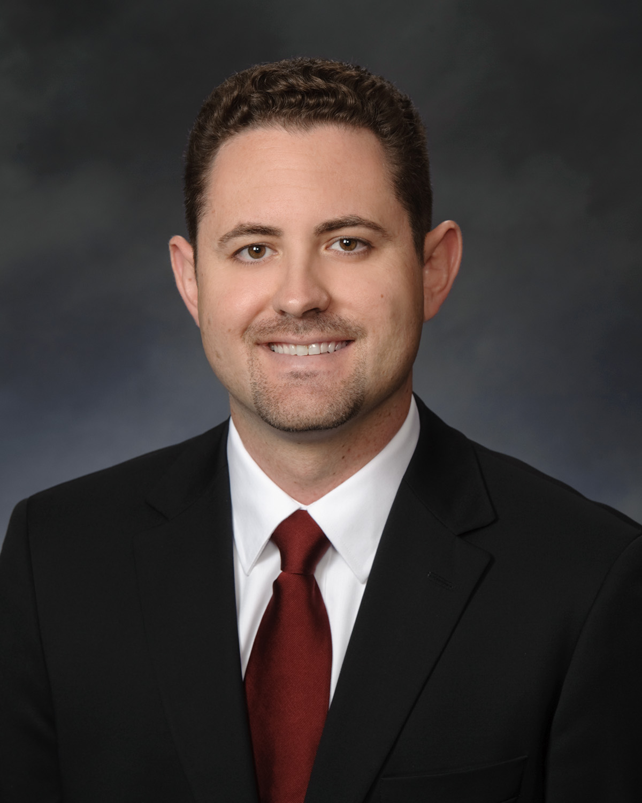
Presented by Capitol Advisors:
Barrett Snider
Partner
barrett@capitoladvisors.org

